Slide 1

Duck Persona: AI-Powered Personalized Code Debugging Assistant
Foundations Of Artificial Intelligence
Department Of CSE
Team Members:
Mithulesh S - 240701314
Nishanth B - 240701364

Slide 2
Abstract
Duck Persona – AI-Based Personalized Code Debugging Assistant
Duck Persona is an AI-powered coding assistant designed to make debugging easier and more engaging for students and beginner programmers.
The system allows users to paste buggy code written in different programming languages and choose one of three unique duck personalities: Socratic, Grumpy, or Hype. Based on the selected personality, the system identifies errors, provides corrected code, and explains the mistake in a particular teaching style.
The project uses Gemini API, Python Flask, JavaScript, HTML, CSS, JSON database, and Node.js modules, with the A* search algorithm used as part of the solution approach.
The main idea is simple: instead of just fixing the code, Duck Persona helps the user understand the mistake and learn how to avoid it in the future.

Slide 3
Problem statement
Learning programming often involves dealing with errors, but beginners may find error messages confusing or difficult to understand.
Problems Faced by Students
Beginners often struggle to understand why their code is not working.
Error messages can be technical and difficult to interpret.
Online solutions often give the corrected code without properly explaining the mistake.
Different students learn better through different teaching styles.
Continuous debugging can become frustrating and reduce motivation.
Existing coding assistants generally provide similar responses regardless of the user's preferred learning style.
Problem Statement:
“To develop an AI-based coding assistant that can identify and correct programming errors while explaining them in a personalized and engaging way through different AI personalities.”

Slide 4
Literature survey
Area Studied | What It Provides | Limitation
Traditional Debugging Tools | Identifies syntax and runtime errors | Explanations can be difficult for beginners
Online Coding Platforms | Coding practice and error feedback | Feedback is mostly standardized
AI Coding Assistants | Code generation and correction | Limited personality-based teaching
Intelligent Tutoring Systems | Personalized learning support | Often designed for specific subjects
AI Chatbots | Conversational explanations | May not focus specifically on debugging
Gamified Learning | Makes learning more engaging | Limited focus on code correction
Survey Observation:
The literature shows that AI can provide useful support for programming education. However, there is still scope for making debugging more interactive, personalized, and enjoyable

Slide 5
Research gap
From the literature survey, the following gaps were identified:
Most debugging systems focus mainly on finding and fixing errors.
Many systems do not explain the error according to the learner's preferred style.
Generic AI assistants do not always provide a consistent personality.
There is limited integration of character-based interaction with programming education.
Debugging can still feel like a technical and frustrating process for beginners.
Identified Research Gap:
“There is a need for a debugging assistant that combines AI-based code correction with personalized teaching personalities, making the debugging process both educational and engaging.”

Slide 6
Research objectives
The main goal of Duck Persona is to make programming support more personalized and
learner-friendly. The objectives are as follows:
Develop an AI platform for debugging programs.
Support multiple programming languages.
Detect errors and provide corrected code.
Explain errors in simple language.
Provide three AI-based personalities.
Make debugging interactive and engaging.
Use the A* algorithm for efficient solution selection.
Three Duck Personalities:
Socratic Duck: Guides users through questions and encourages independent thinking.
Grumpy Duck: Directly identifies mistakes with a humorous, annoyed tone.
Hype Duck: Uses positive energy and encouragement to make debugging fun.

Slide 7
Proposed work
Proposed System
The user first pastes their buggy code and selects a preferred Duck Persona.The system then
analyzes the code, identifies the problem, generates a suitable correction, and explains the solution
according to the selected personality.
Working Flow
Enter Buggy Code
Select Programming Language
Select Duck Personality
Send Request to Flask Backend
AI Analysis using Gemini API
A* Based Solution Selection
Generate Corrected Code
Explain the Error
Display Personalized Response

Slide 8
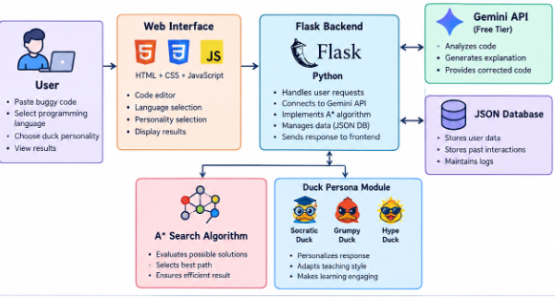
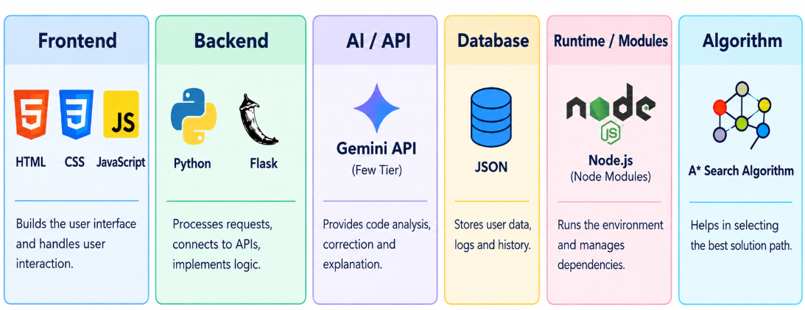
ARCHITECTURE DIAGRAM
TECHNOLOGY STACK

Slide 9
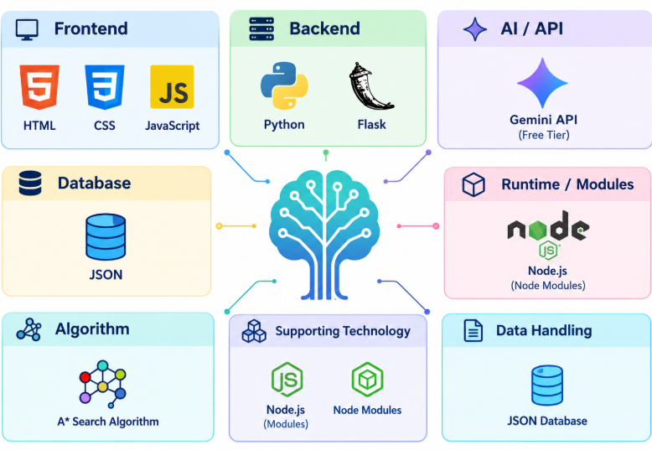
TECHNOLOGies USED
1) Frontend - HTML, CSS JS
2) Backend - Python , Flask
3) AI Technology - Gemini API (Free Tier )
4) Database - JSON Database
5) Supporting Technology - Node.js, Node Modules
6) Algorithm - A* Search Algorithm

Slide 10
A* search algorithm
Basic Concept
The A* algorithm is a search algorithm that finds an efficient path from an initial state to a desired goal state.
It uses:
f(n) = g(n) + h(n)
Where:
g(n) - Cost from the starting state to the current state
h(n) - Estimated cost from the current state to the goal
f(n) - Total estimated cost
Application in Duck Persona
The debugging process can be viewed as a sequence of possible states:
Buggy Code > Error Identification > Possible Solutions > Solution Evaluation > Best Solution > Corrected Code

Slide 11
implementation
Duck Persona is implemented as a web application where the user interacts with the system through a simple coding interface.
The frontend is developed using HTML, CSS, and JavaScript, while Python Flask handles the backend processing. The Gemini API is used for AI-based code analysis and personalized responses.
Implementation Steps:
User opens the Duck Persona application.
User selects a programming language.
User pastes buggy code.
User selects Socratic, Grumpy, or Hype Duck.
The request is sent to the Flask backend.
The backend processes the input.
Agent analyzes the code.
The system generates the correction and explanation.
The selected Duck Persona presents the response.
The user can understand the error and learn from the correction.

Slide 12
System requirements
Hardware
Processor: AMD Ryzen 5
RAM: 4 GB or above
Storage: 500 MB or above
Stable Internet connection
Keyboard and mouse
Standard display
Software
Python
Flask
Node.js
Web Browser
Antigravity (or) Any IDE Editor
Gemini API access Key

Slide 13
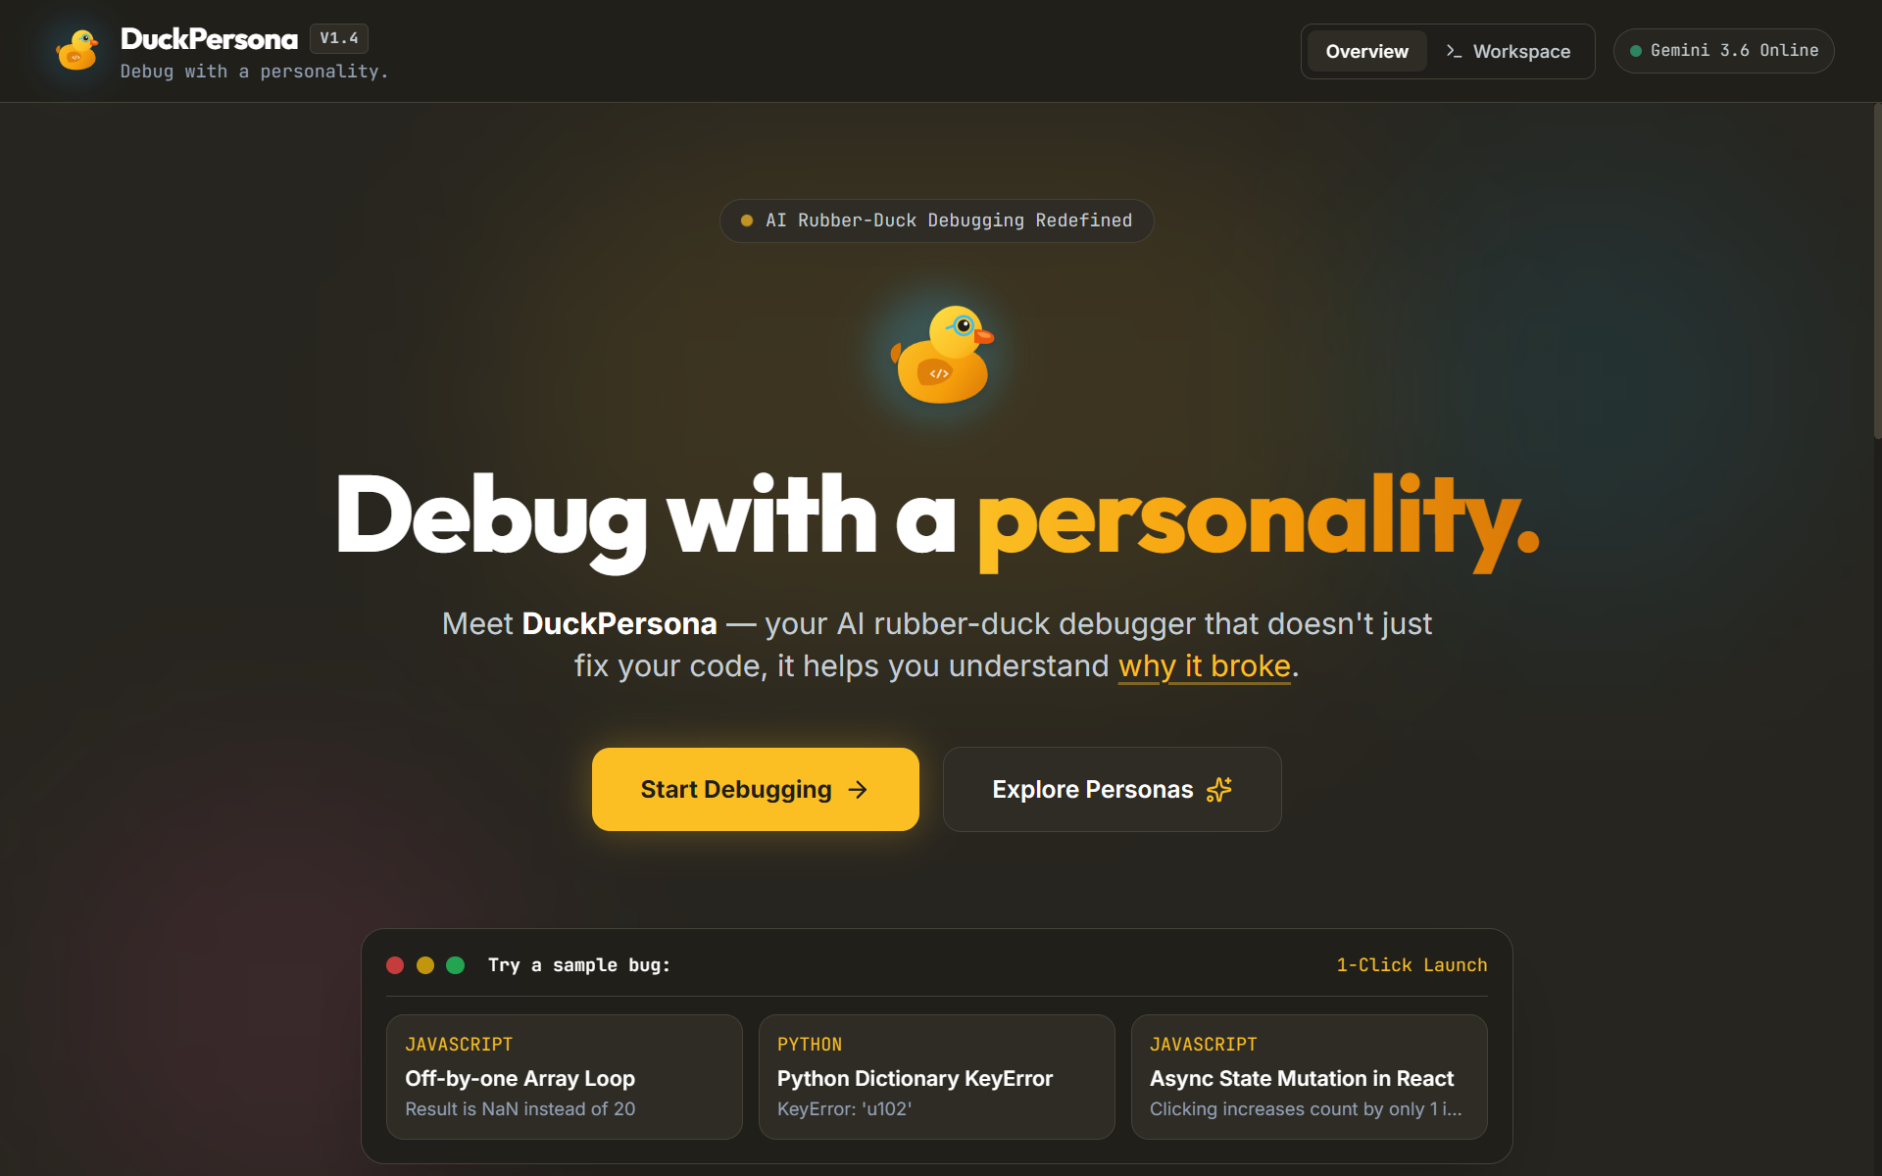
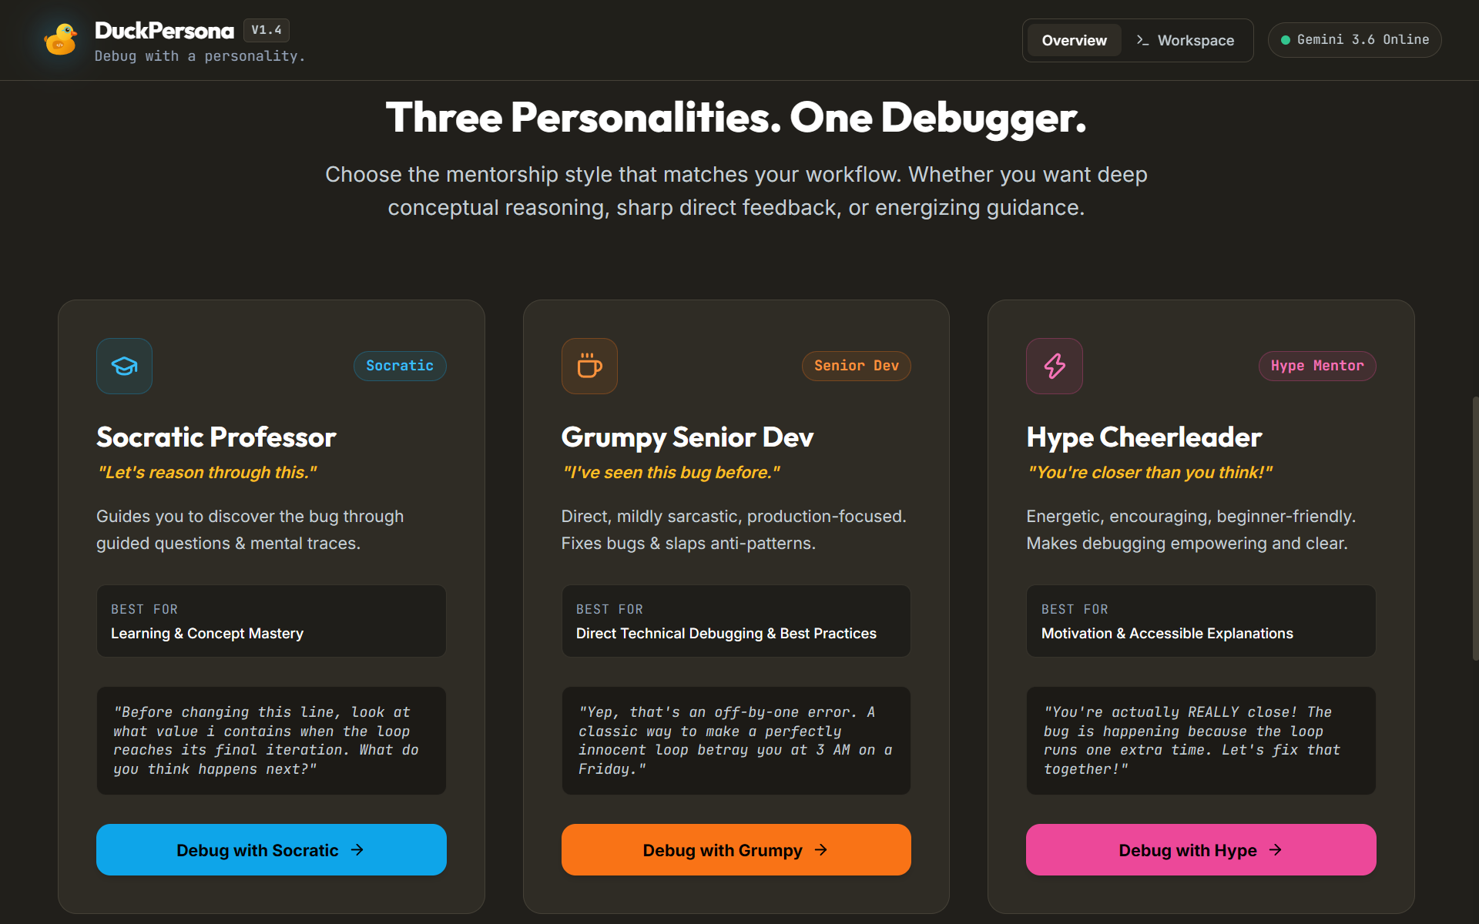
OUTPUT AND RESULT
Fig 1: Home Page
Fig 2: Personality Selection

Slide 14
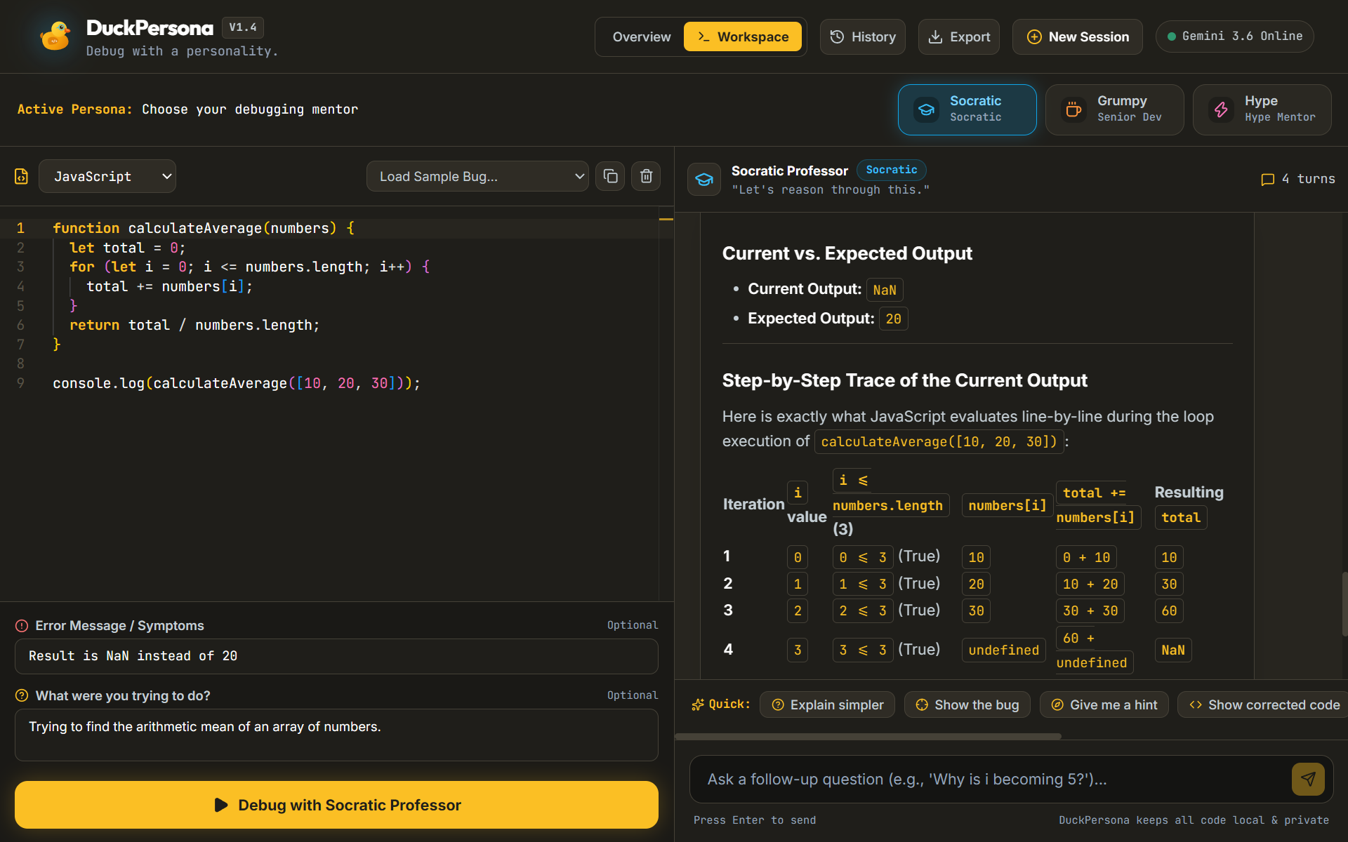
Fig 3: Socratic Personality Output

Slide 15
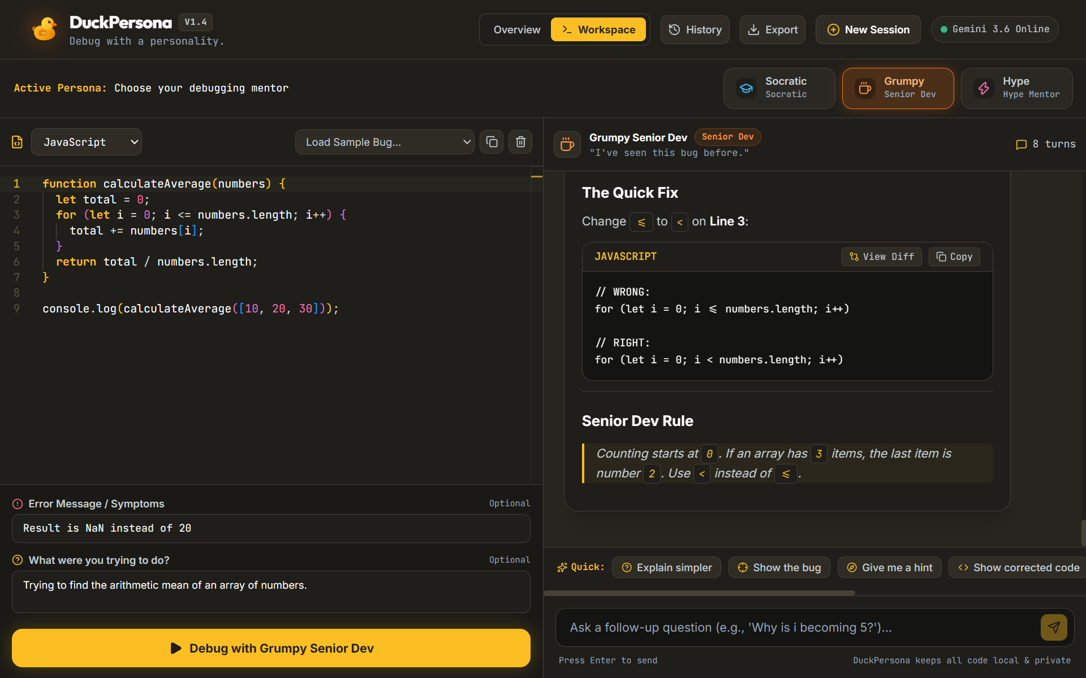
Fig 4: Grumpy Personality Output

Slide 16
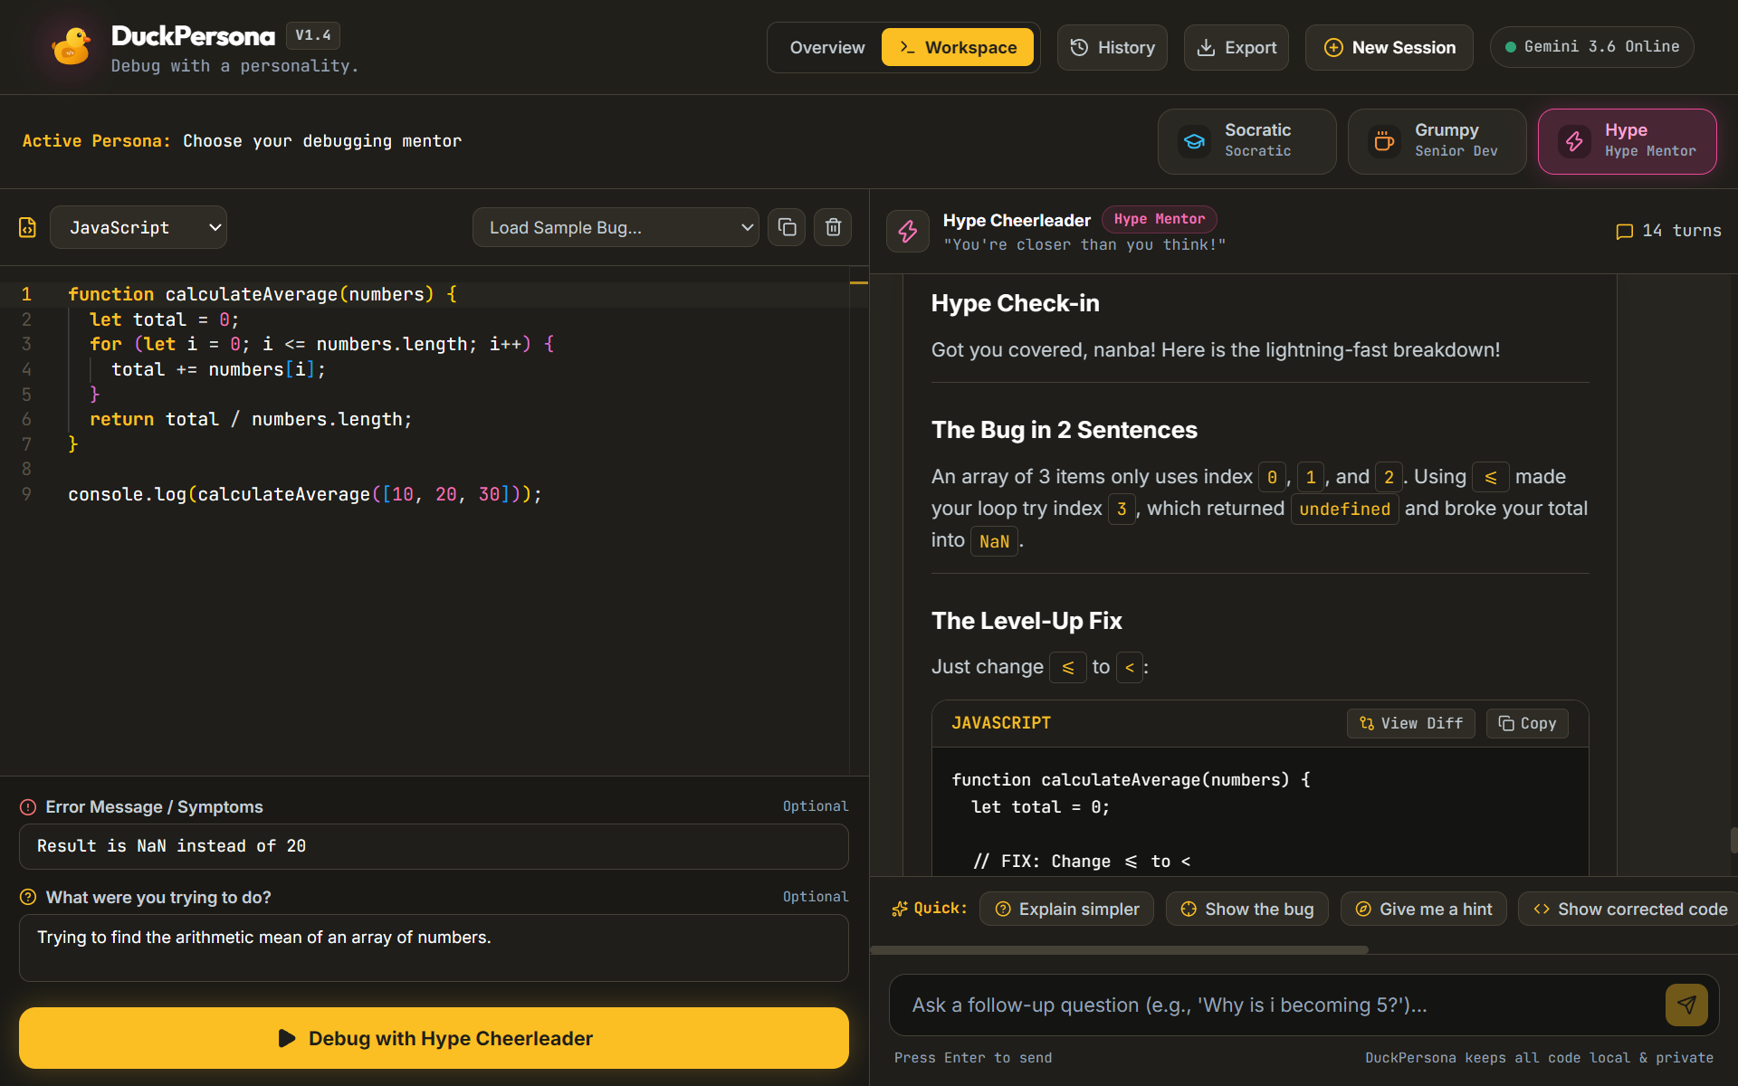
Fig 5: Hype Personality Output

